Slide 1
IBM University Engagement Project Submission
“Exploring the power of Agentic AI with IBM Cloud and Orchestrate”

Slide 2

Project Title: Audio Signal Processing Assistant Agent Domain of the Project: Education
Student Name | Passport Photo | Email ID | Mobile Number
Garshakurthi Ajay |  | ajaygarshakurthi9@gmail.com | 7013080514

Slide 3
Problem Statement: Audio Signal Processing Assistant
The Challenge:
Audio Signal Processing is one of the most important subjects in Electronics, Communication Engineering, Embedded
Systems, Artificial Intelligence, and Multimedia applications. However, students and professionals often face difficulties in
understanding complicated theoretical concepts such as Fourier Transform, Fast Fourier Transform (FFT), Digital Filters,
FIR and IIR Filters, Sampling Theorem, Aliasing, Modulation, Operational Amplifiers, Signal Reconstruction, and Noise
Reduction.
The Objective:
The objective of this project is to build an AI-powered Audio Signal Processing Assistant using IBM watsonx Orchestrate
and GPT-OSS-120B
that serves as a virtual educational assistant for students, educators, and professionals.
The proposed system aims to:
Provide instant answers to Audio Signal Processing questions.
Explain DSP concepts in beginner-friendly language.
Simplify complex mathematical and theoretical topics.
Answer questions related to filters, sampling, FFT, aliasing, modulation, and amplifiers.
Deliver conversational AI support through an interactive chatbot.
Maintain chat history for continuous conversations.
Allow users to download previous conversations for future reference.
Improve the learning experience through AI-powered educational assistance.

Slide 4
Proposed Solution
Proposed Solution: AI-Powered Audio Signal Processing Assistant
The proposed solution is an intelligent educational chatbot developed using IBM watsonx
Orchestrate SDK, GPT-OSS-120B, Python, and Streamlit.
The application acts as a virtual tutor that enables users to ask questions related to Audio Signal
Processing and instantly receive detailed, context-aware explanations generated by a Large Language
Model (LLM).
The system accepts user queries through a modern Streamlit interface. The user's question is securely
transmitted to IBM watsonx Orchestrate, which authenticates the request and forwards it to the GPT-
OSS-120B model. The language model processes the request, understands the technical context, and
generates an educational response.
The generated answer is displayed within the chat interface while preserving the complete
conversation history. Users can continue asking follow-up questions, allowing the AI to maintain
conversational context and provide more meaningful explanations.
The application includes several educational features such as suggested questions, downloadable
conversation history, responsive user interface, dark theme design, and interactive chat capabilities.
Overall, the proposed solution provides a simple, intelligent, and accessible learning platform that
helps users understand difficult Audio Signal Processing concepts through natural language interaction.

Slide 5
Technology Used
The project utilizes several modern AI and web development technologies to build an
intelligent educational assistant.
IBM watsonx Orchestrate SDK- Used to securely communicate with IBM-hosted Large
Language Models while handling authentication and model orchestration.
GPT-OSS-120B- A powerful open-source Large Language Model used for reasoning, technical
explanations, and educational question answering.
Python- Primary programming language used to implement the backend logic and integrate AI
services.
Streamlit- Used to build a responsive and interactive web application with minimal development
effort.
HTML & CSS- Used to customize the appearance of the chatbot interface and improve user
experience.
GitHub- Used for version control, project collaboration, and source code management.
Streamlit Community Cloud- Used to deploy the project online and make it accessible through
a web browser.
Dotenv-Used to securely manage environment variables during local development.

Slide 6
Components Used
The project is developed using IBM watsonx Orchestrate SDK instead of LangFlow. The following
components are integrated within the application.
Chat Input Component- Accepts user questions related to Audio Signal Processing.
IBM watsonx Orchestrate SDK- Handles secure communication with IBM AI services and
authenticates requests.
GPT-OSS-120B Model- Processes user queries and generates intelligent educational responses.
Chat Output Component- Displays AI-generated responses in a conversational format.
Session State- Stores the complete chat history throughout the user session.
Download Component- Allows users to export the complete conversation as a text document.
Streamlit Interface- Provides an intuitive and responsive graphical interface for users.

Slide 7
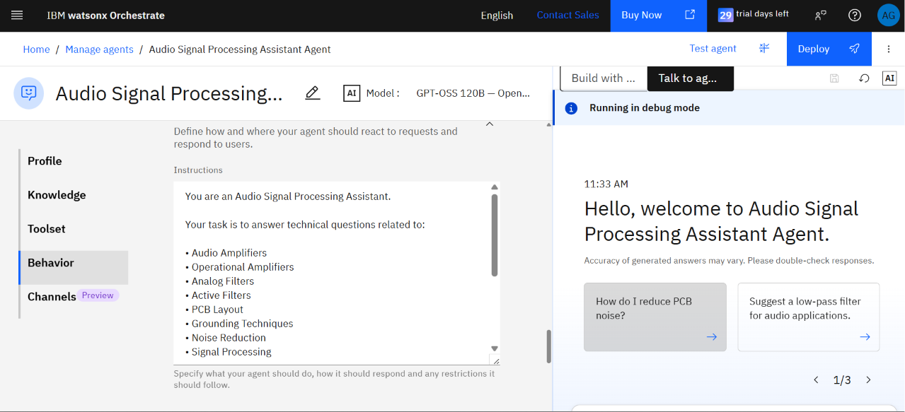
Agent instructions Screenshot

Slide 8
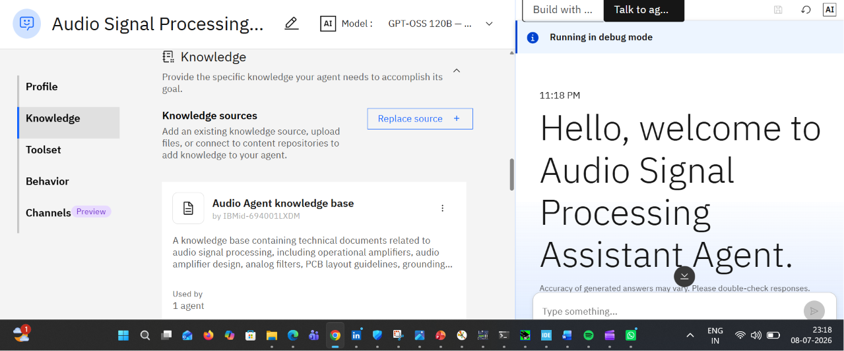
Document uploaded Screenshot

Slide 9
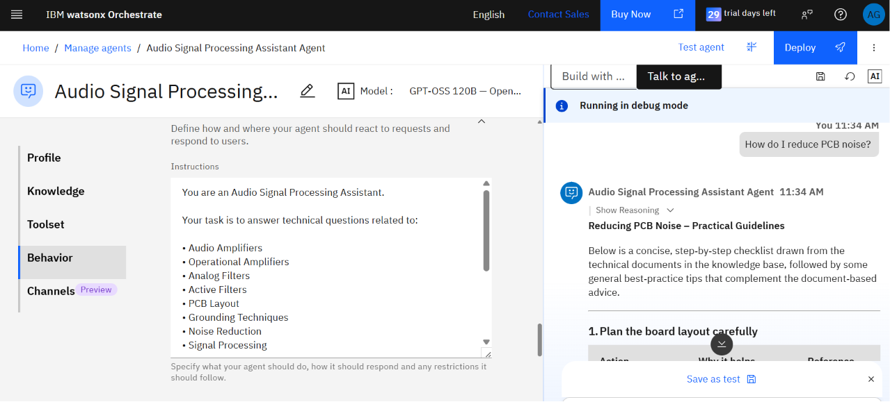
Prompt with output screenshot

Slide 10
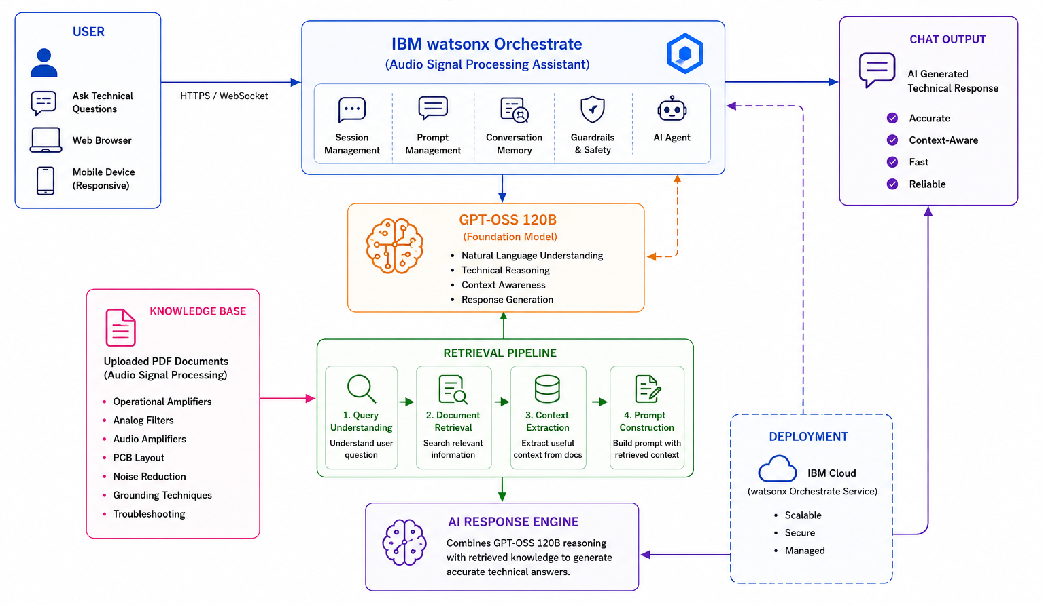
Architecture Blueprint

Slide 11
LangFlow Components Used
Chat Input- The Chat Input component serves as the entry point of the workflow. It allows
users to enter questions related to Audio Signal Processing through a conversational
interface. The component captures user queries and forwards them to the AI agent for
processing.
Agent -The Agent is the core component of the application. It is configured with the IBM
watsonx Orchestrate GPT-OSS-120B language model and custom instructions to behave as an
Audio Signal Processing expert. The agent understands user queries, performs reasoning, and
generates accurate educational responses.
Language Model (Connected inside the Agent)- The Agent is connected to the GPT-OSS-
120B Large Language Model available through IBM watsonx Orchestrate. This model performs
natural language understanding, reasoning, and response generation.
Agent Instructions- The Agent Instructions define the behavior of the AI assistant. They specify that the
model should act as an Audio Signal Processing expert and provide accurate, beginner-friendly
explanations while remaining focused on the subject domain.
Chat Output- The Chat Output component displays the response generated by the AI agent. It provides an
interactive conversational interface where users can read explanations and continue asking follow-up questions.

Slide 12
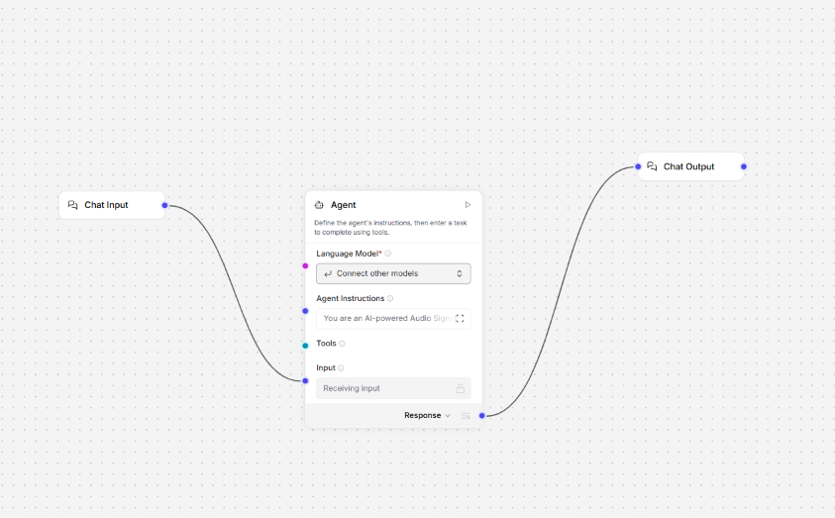
Langflow

Slide 13
Role of Agentic AI in the Solution
Role of Agentic AI in the Solution
Agentic AI plays a central role in transforming the application from a traditional question-answering
system into an intelligent educational assistant.
Instead of returning predefined answers, the AI understands the user's intent, interprets technical
terminology, reasons about the requested topic, and generates educational responses dynamically.
The GPT-OSS-120B model performs advanced reasoning to explain difficult Audio Signal Processing
concepts in a simplified manner. IBM watsonx Orchestrate manages authentication, secure
communication, and model access, enabling seamless interaction between the user and the AI
model.
Agentic AI allows the system to:
Understand natural language questions.
Explain technical DSP concepts.
Maintain conversation context.
Generate personalized educational responses.
Support continuous learning through conversational interaction.
Adapt explanations according to user questions.
This intelligent behavior makes the assistant function like a virtual tutor rather than a simple chatbot.

Slide 14
GitHub link:
Github Link: https://github.com/AjayGarshakurthi/Audio_Signal_processing_Assistant_Agent
Streamlit Deployment Link:
Audio Signal Processing Assistant · Streamlit

Slide 15
Novelty and Uniqueness
The proposed Audio Signal Processing Assistant introduces several innovative features that distinguish
it from conventional educational chatbots.
Intelligent Educational Assistant- Provides AI-generated explanations specifically focused on
Audio Signal Processing.
IBM watsonx Orchestrate Integration- Uses IBM enterprise-grade AI infrastructure for secure
authentication and model orchestration.
GPT-OSS-120B Integration- Leverages advanced reasoning capabilities for generating detailed
technical explanations.
Interactive Learning- Supports continuous conversation rather than isolated question answering.
Downloadable Conversations- Allows students to save AI-generated explanations for later study.
Beginner-Friendly Explanations- Converts complex engineering concepts into easy-to-understand
language.
Cloud Deployment- Accessible online through Streamlit Community Cloud without local installation.
Responsive User Interface-Designed with an intuitive dark theme for improved usability.

Slide 16
Future Scope
Voice-Based Assistant- Integrate Speech-to-Text and Text-to-Speech so users
can interact using voice commands.
PDF-Based Learning- Enable users to upload lecture notes, textbooks, or
research papers and ask questions using Retrieval-Augmented Generation (RAG).
Audio File Analysis- Allow users to upload WAV or MP3 files for waveform
visualization, frequency analysis, FFT computation, and noise analysis.
Circuit Diagram Recognition- Automatically analyze and explain analog and digital audio
circuit diagrams.
DSP Simulations- Provide interactive demonstrations of digital filters, FFT, convolution,
modulation, and sampling.
Multilingual Support- Support multiple regional and international languages to make the
application accessible to a broader audience.
Student Learning Dashboard- Track user learning progress, frequently asked questions, quiz
performance, and personalized recommendations.
AI Tutor Mode- Introduce adaptive tutoring that provides quizzes, coding exercises, and practical
DSP problems based on the learner's proficiency level.

Slide 17
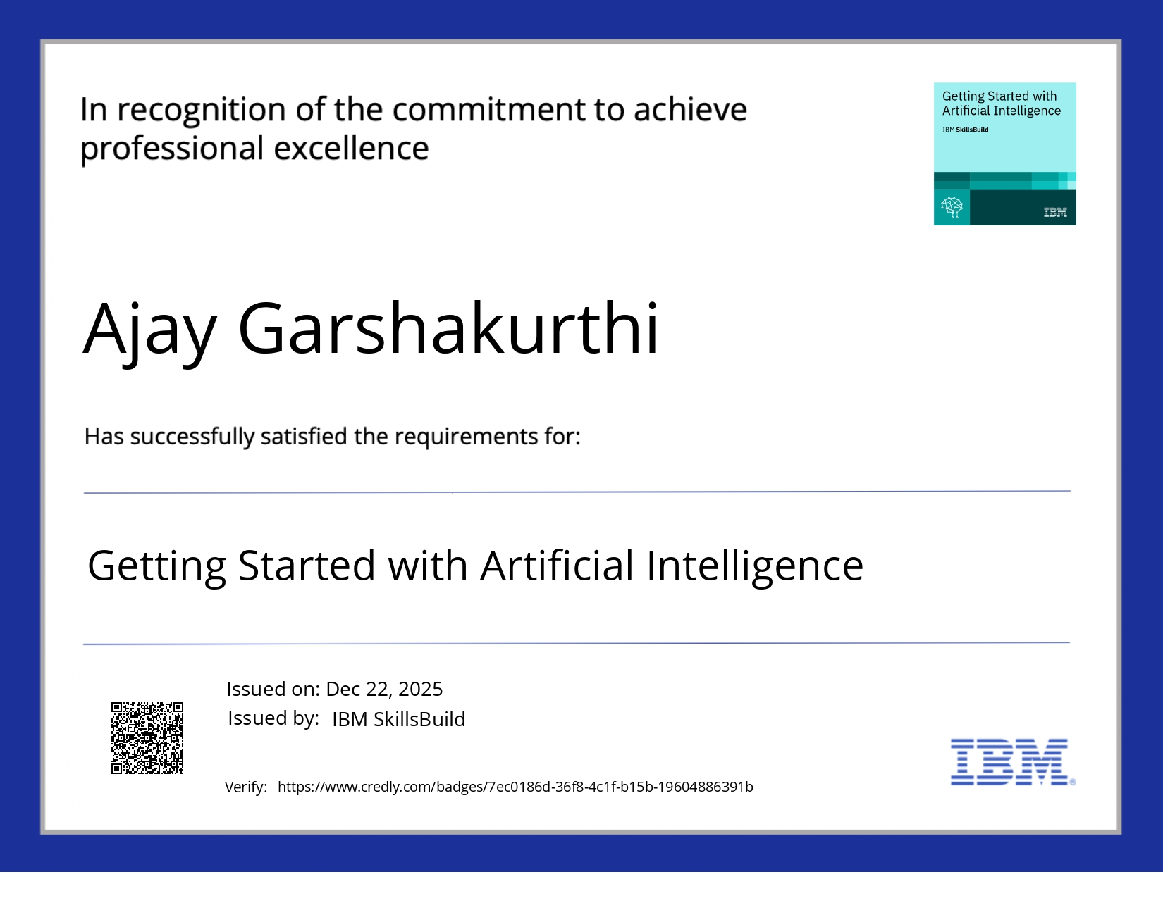
Certificates Earned:

Slide 18
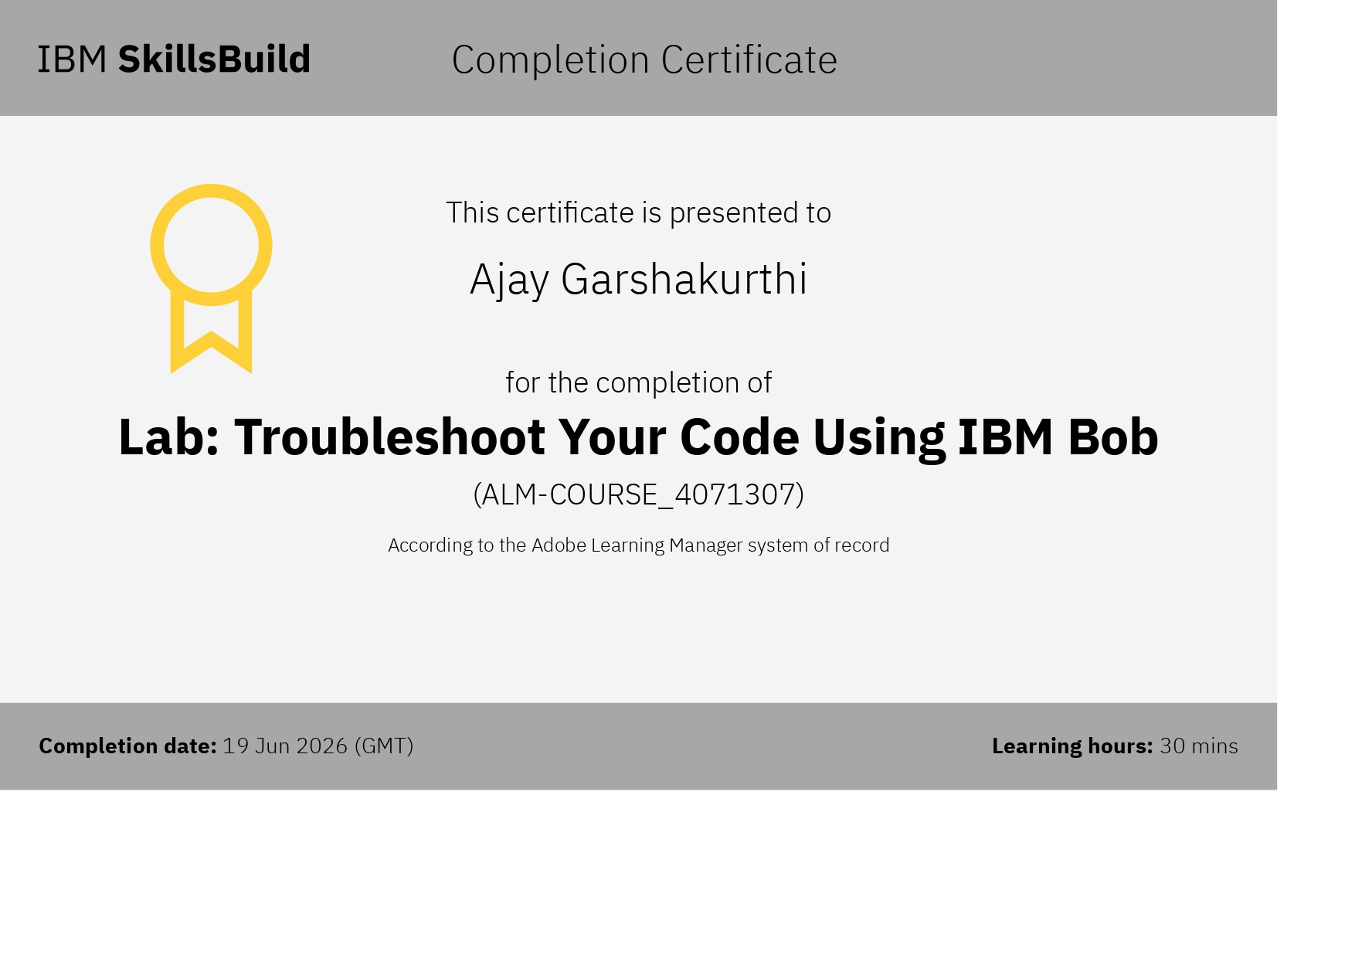

Slide 19
THANK YOU!
Thank you for your interest and time

